Slide 1
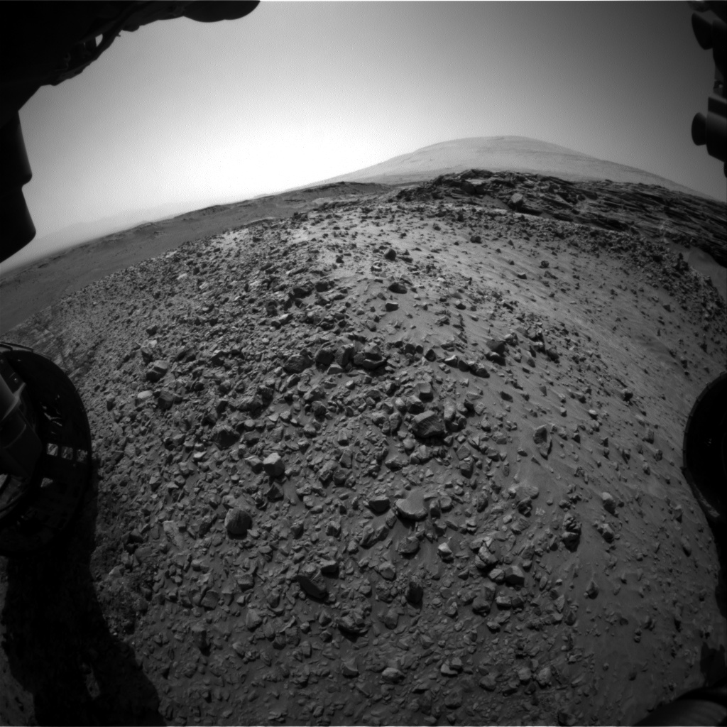
Lowder Legends
Austin Mccombs
1st year masters student
Pursuing information systems Masters
Undergrad: supply-chain
Alex Johnson
1st year masters student
Pursuing dual-degree mba & information systems
Undergrad: Industrial & Systems Engineering
Sarvesh jarnarathan
1st year Masters student
Undergrad & present: aerospace engineering

Slide 2
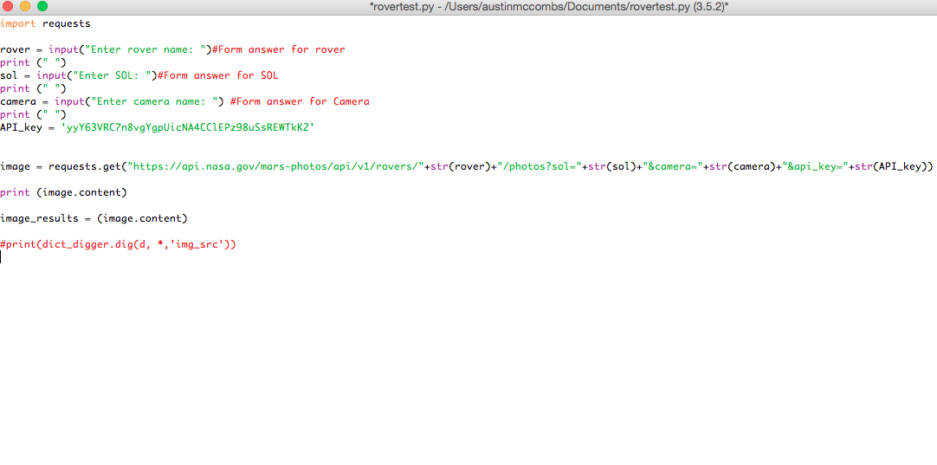
Source Code
Notes:
Presenter explain method, and challenges that arose as a result of using Python/

Slide 3
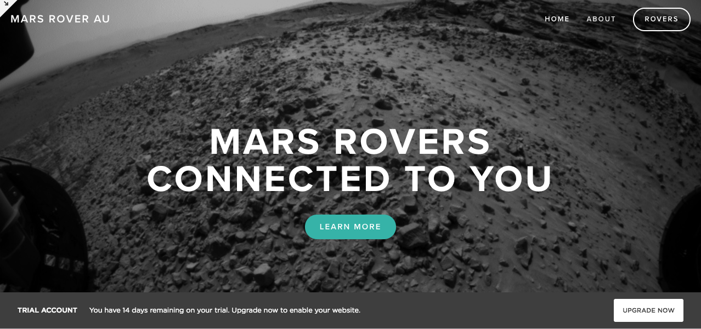
Website
Notes:
Squarespace utilization [trial account, ha ha]

Slide 4
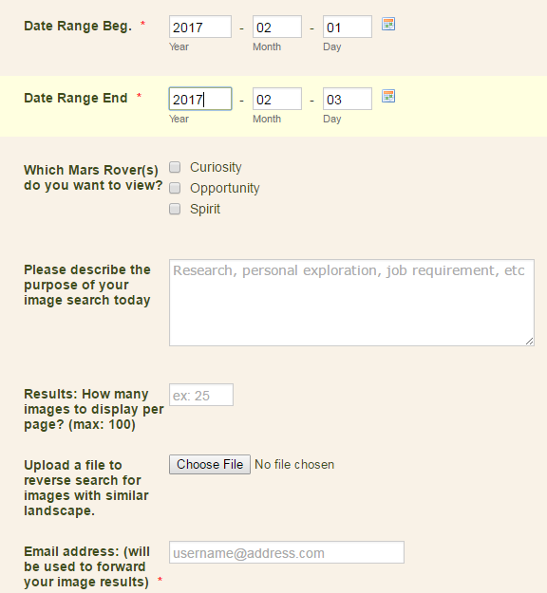
User Form
Notes:
Presenter explain the challenges that were overcame in creating this and integration.

Slide 5
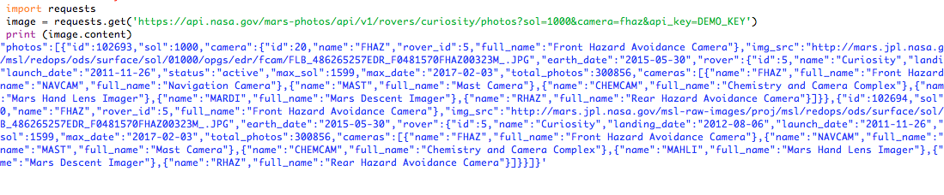
Query Results
URL that provides image requested. (may be more than one result per query)
Notes:
Results from user input [within python]

Slide 6
Image Output
Notes:
Send back the result of the query, and perform the transformation of image output.

